Slide 1
Build your project in a day

Slide 2

Competition overview for students video
Notes:
Welcome Students to Imagine Cup Junior 2022
Leigh Cresswell, Director, Future Ready Skills
Pablo Veramendi, Global Competition Manager, Imagine Cup
Tina Jones, Business Strategy Lead, Azure Skills and Employability

Slide 3
Check in
Things to remember for today…

Slide 4
Keep moving forward
[There’s a lot to cover, so remember to keep going!]

Slide 5
Don’t steal ideas
[You can help each other, but don’t steal – this is still a competition!]

Slide 6
Fight, then unite
[Don’t be afraid to challenge each other’s ideas. It will make your team’s project stronger in the end.]

Slide 7
Make the world better
[The goal is to think of an idea that makes the world a better place.]

Slide 8
Always listen
[You never know when someone will give you a good idea!]

Slide 9
What is AI?
[covering the basics]

Slide 10

AI is quite simply…
an attempt to make a computer, a robot, or other piece of technology ‘think’ and do some things like humans.
Notes:
Here we define what artificial intelligence is. There are plenty of definitions out there, but in Imagine Cup Junior for Beginners we use this simple overview. ‘Artificial Intelligence is an attempt to make a computer, a robot, or other piece of technology ‘think’ and process data in the same way as we humans do.’
You can also use some of the slides within Lesson 2 “What is AI” to assist in giving your students a foundation in AI.

Slide 11
Karon video
Notes:
Welcome from Karon Weber, Partner Director, Education Workshop

Slide 12
Check in
What are the ethics of AI?

Slide 13
Dan Morris video
Notes:
AI for Good and Responsible AI, Dan Morris, Principal Scientist, AI for Earth

Slide 14
The Microsoft ethics principles
Fairness
Treat all people fairly and equally.
Reliability & Safety
Perform reliably and safely.
Privacy & Security
Respect everyone’s privacy.
Inclusiveness
Empower and engage everyone.
Transparency
AI systems should be easy-to-understand.
Accountability
AI systems should be responsible and have algorithmic accountability.

Slide 15
AI for Good Challenge
[time to get started]

Slide 16
Key dates
3 February
Submission opens
12 May
Competition closes
8 June
Regional winner announcements begin
9 June
Global winner announcements

Slide 17
How your ideas are scored?
innovation
20%
buildability
20%
impact
20%
presentation
20%
ethics
20%

Slide 18
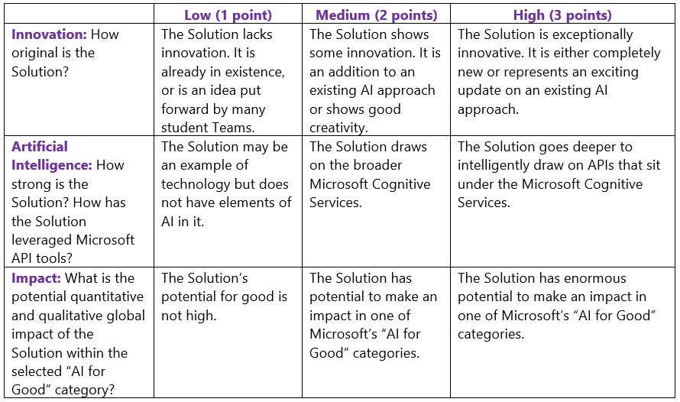
Criteria
Judges will assign 1, 2, or 3 points for each criterion:

Slide 19
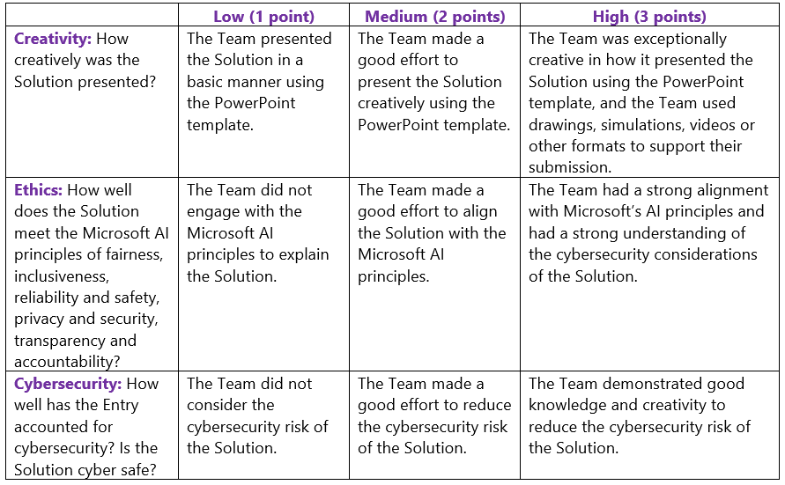
Criteria, cont’d
Judges will assign 1, 2, or 3 points for each criterion:

Slide 20
Building your project
1.
Find a problem to solve
2.
Understand the problem
3.
Find possible solutions
4.
Select and build your ideas
5.
Check the Microsoft AI Principles and Ethics
6.
Submit your project

Slide 21
1.
Find a problem to solve
2.
Understand the problem
3.
Find possible solutions
4.
Select and build your ideas
5.
Check the Microsoft AI Principles and Ethics
6.
Submit your project

Slide 22
Check in
Which initiative inspires you the most?
Accessibility ● Earth ● Health ● Humanitarian Action ● Cultural Heritage

Slide 23
AI for Accessibility

Slide 24
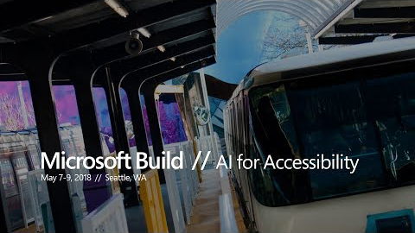
Notes:
Microsoft Build: AI for Accessibility
We believe technology can empower everyone to achieve more, and we’re seeing it come to life. AI is opening the door to a new wave of possibilities—and we’re just getting started. Let’s see what you can do.
https://youtu.be/bbrZ2pvubL0

Slide 25
AI for Earth

Slide 26
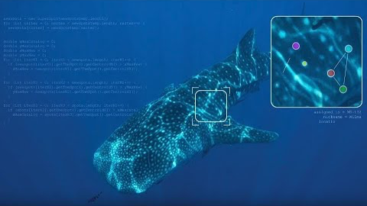
Video with captions available here: https://youtu.be/rQqao37u1wU
Notes:
Fighting extinction with Microsoft AI and citizen science
Microsoft’s AI for Good initiative empowers people around the world working to solve humanitarian issues and create a more sustainable and accessible world. Learn how Wild Me is using computer vision and deep learning algorithms to power Wildbook, a platform that utilizes technology to scan and identify individual animals and species.
https://youtu.be/rQqao37u1wU

Slide 27
AI for Health

Slide 28

Video with captions available here: https://www.youtube.com/watch?v=ii-FfE-7C-k
Notes:
Tackle some of the toughest challenges in global health with Microsoft AI
Microsoft is expanding on its existing AI for Good initiative by launching the AI for Health program. AI for Health empowers researchers and organizations with AI to advance the health of people and communities around the world.
https://www.youtube.com/watch?v=ii-FfE-7C-k

Slide 29
AI for Humanitarian Action

Slide 30
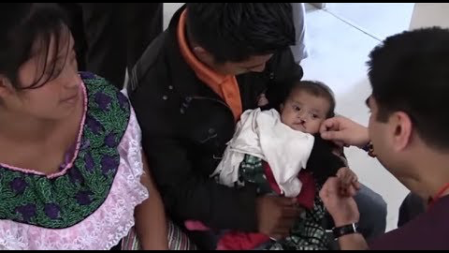
Video with captions available here: https://youtu.be/7VqH9mVSWlg
Notes:
Microsoft Ignite: AI For Humanitarian Action
New technologies are rapidly changing the way we live, learn, and work. This rapid transformation is creating extraordinary opportunities for people around the world. AI is opening the door to a new wave of possibilities—and we’re just getting started.
https://youtu.be/7VqH9mVSWlg

Slide 31
AI for Cultural Heritage

Slide 32
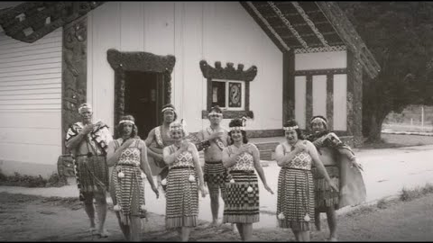
Video with captions available here: https://youtu.be/h8-0g0rlhKM
Notes:
Microsoft Ignite: AI For Cultural Heritage
AI for Cultural Heritage leverages the power of AI to empoyer people and organisations dedicated to the preservation and enrichment of cultural heritage.
https://youtu.be/h8-0g0rlhKM
Link for screenshot: https://www.microsoft.com/en-us/ai/ai-for-cultural-heritage

Slide 33
Check in
Work together in groups of 3-6 people and decide which AI for Good Initiative to focus on.

Slide 34
Action
Define the problem you want to solve.
“It is unacceptable that…”

Slide 35
Examples.
AI for Earth Initiative
“It is unacceptable that there is so much trash in the ocean.”

Slide 36
Examples.
AI for Health Initiative
“It is unacceptable that people living in poverty can’t access high quality, affordable health services.”

Slide 37
Examples.
AI for Accessibility
Initiative
“It is unacceptable that most restaurant menus are not accessible for our friends with dyslexia.”

Slide 38
Examples.
AI for Humanitarian Action Initiative
“It is unacceptable that there are still widespread gender and race wage gaps.”

Slide 39
Examples.
AI for Cultural Heritage Initiative
“It is unacceptable that there are important historical monuments that are being lost to the world.”

Slide 40

Action
YOUR TURN!
On a post-it note, finish this sentence using a topic you’re passionate about:
“It is unacceptable that…”

Slide 41
Team Name

Slide 42
Action
In your group, come up with an initial team name to represent your shared passion.
Notes:
For example:
‘Reef Assist’ or ‘Wheel Cheer’ or ‘Storm Alert’

Slide 43
1.
Find a problem to solve
2.
Understand the problem
3.
Find possible solutions
4.
Select and build your ideas
5.
Check the Microsoft AI Principles and Ethics
6.
Submit your project

Slide 44
Check in
With your group, discuss and understand the problem you’ve identified.

Slide 45
Brian Marble video
Notes:
Getting started with your AI for Good idea, Brian Marble, Director, AI Marketing

Slide 46
Root Cause Tree

Slide 47
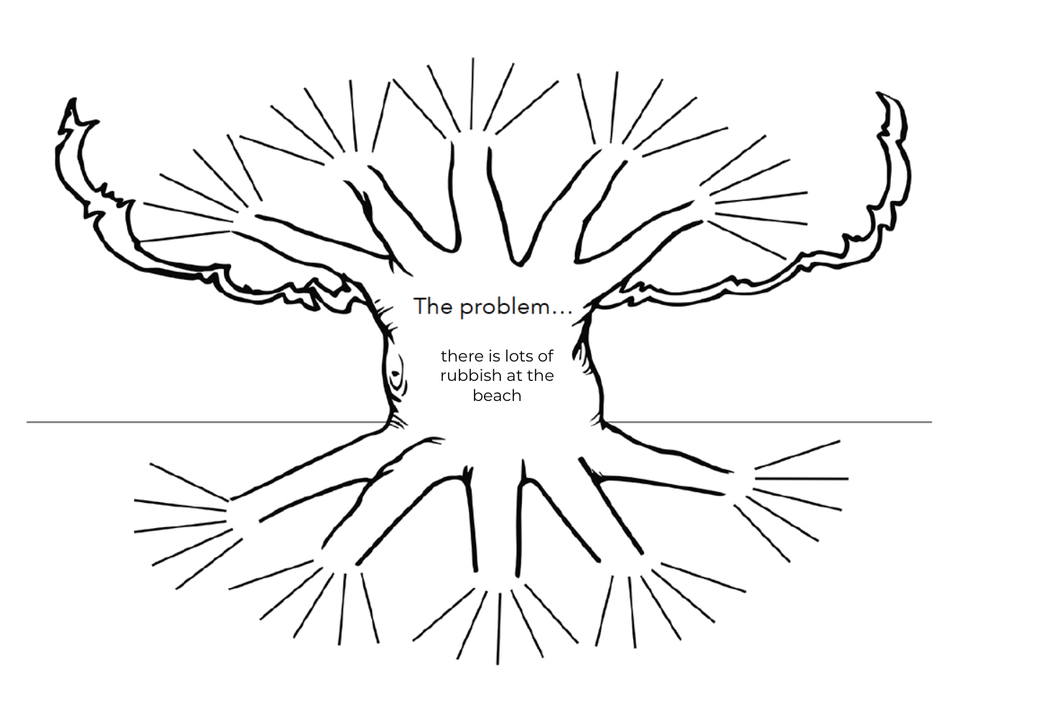
The trunk

Slide 48

Action
Write the problem in the trunk of your tree.

Slide 49
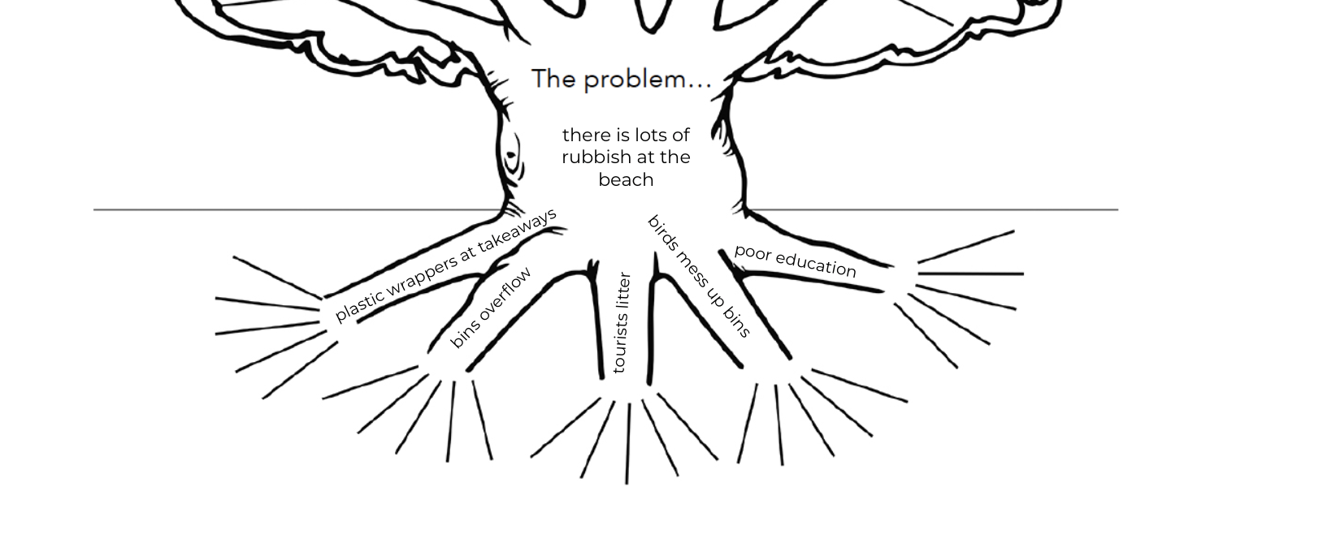
The roots

Slide 50
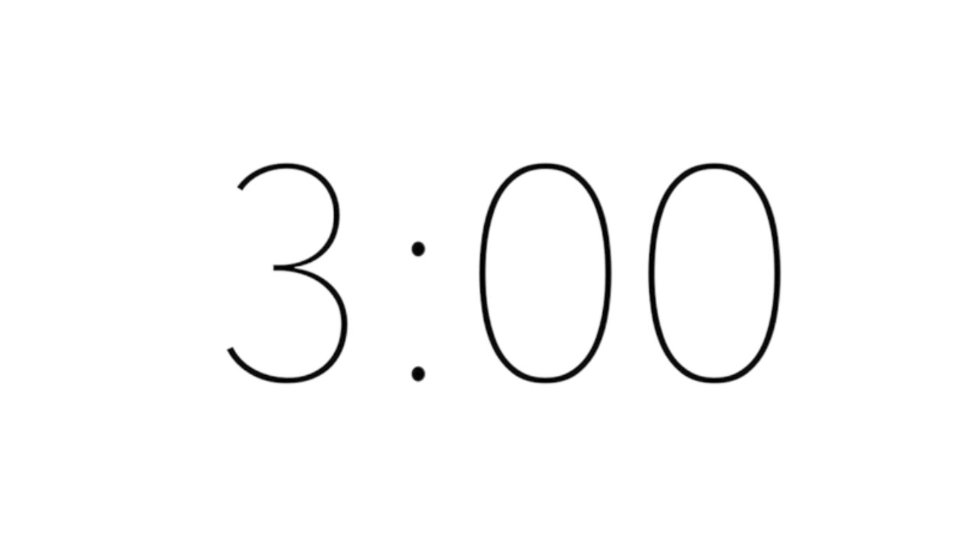
Action
What are the five main causes of your problem? Write them in the roots of your tree.

Slide 51
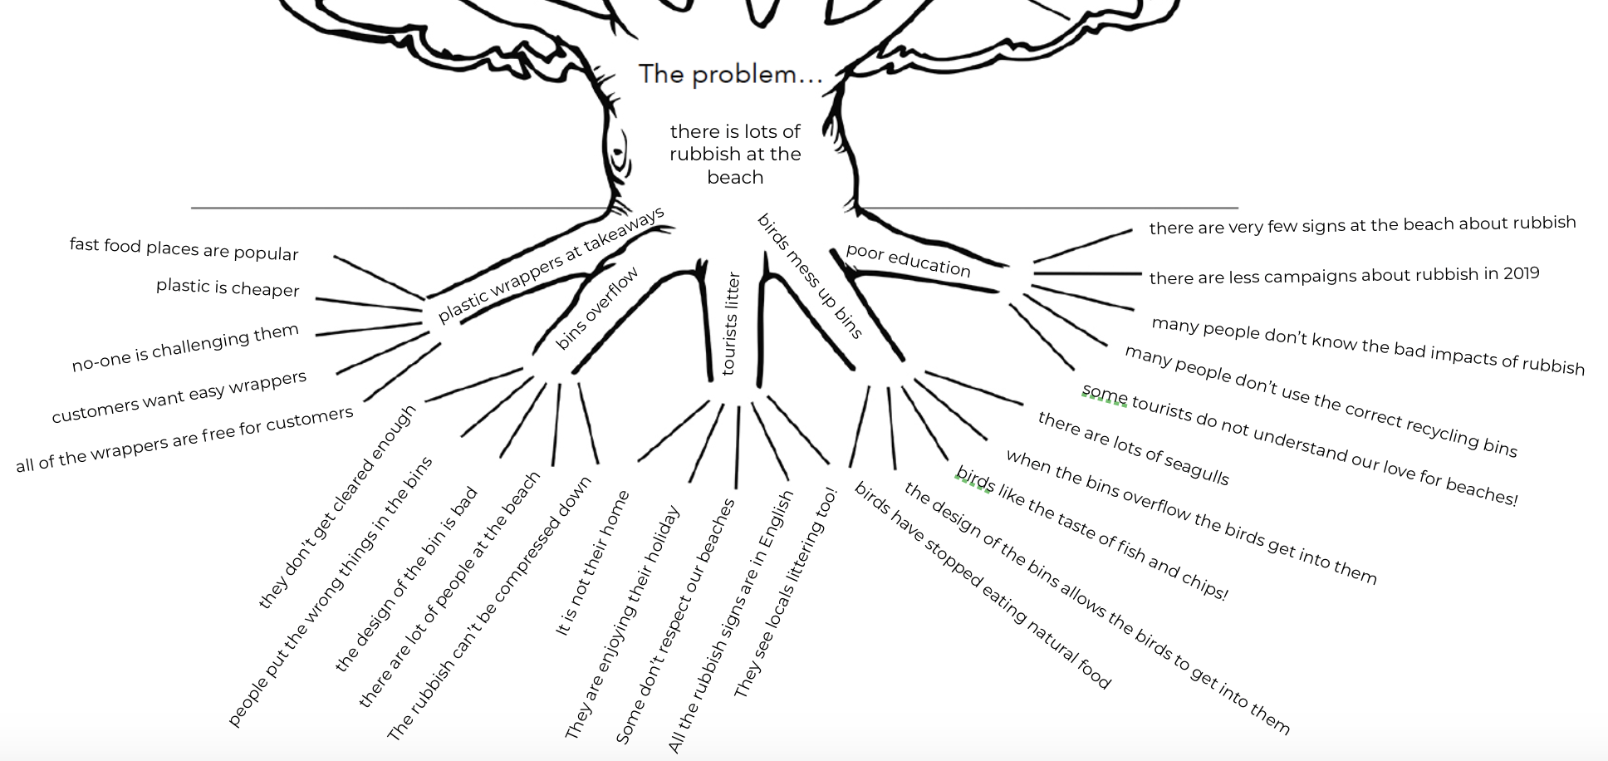
Going even deeper

Slide 52

Action
Dig deeper and keep asking “why” to capture more reasons for each of the roots.

Slide 53
Choose Your Cause

Slide 54
Select the root cause you’d like to solve.

Slide 55
Find Supporting Data

Slide 56
Finding the data.
Here’s an example:
Problem: Unemployment levels for Australians living with disabilities
Research: Website for Australian Network on Disability
Supporting Data: “There are 2.1 million Australians of working age with a disability, but only 1 million are employed.”

Slide 57
1.
Find a problem to solve
2.
Understand the problem
3.
Find possible solutions
4.
Select and build your ideas
5.
Check the Microsoft AI Principles and Ethics
6.
Submit your project

Slide 58
Check in
Start thinking of solutions to the problem and causes you have identified. Try to get 100 solutions!

Slide 59
How Can We?

Slide 60
How can we?
“How can we increase the amount that people recycle?”
“How can we help people who are deaf enjoy concerts more?”
“How can we reduce the number of people affected by traffic accidents?”

Slide 61
Action
Flip your problem into a ”how can we?” question.

Slide 62
Now, select 10 of your best solutions

Slide 63
Innovation Tips

Slide 64
Leigh Cresswell video
Notes:
Working with your team, Leigh Cresswell, Director, Future Ready Skills

Slide 65
Action
Come up with innovative answers to
your team’s “how can we” question.

Slide 66
Share With Other Teams

Slide 67
Action
Get help from other teams to find as many answers to your “how can we” question.

Slide 68
Quiet ideation
How many more answers can you think of on your own?

Slide 69
Action
Work quietly, and alone, to see what other ideas you can come up with. Then, share them with your team.

Slide 70
1.
Find a problem to solve
2.
Understand the problem
3.
Find possible solutions
4.
Select and build your ideas
5.
Check the Microsoft AI Principles and Ethics
6.
Submit your project

Slide 71
Check in
It’s time to pick your best ideas!

Slide 72
Ana Mofarrej video
Notes:
Selecting your winning idea, Ana Mofarrej, Product Marketing Manager, AI for Good

Slide 73
How to select your best ideas.
Which ideas solve your “how can we” question the best?
Which ideas are ethical?
Which ideas could really happen?
Which ideas are you most excited about?

Slide 74
Action
Select your top 5 ideas.

Slide 75
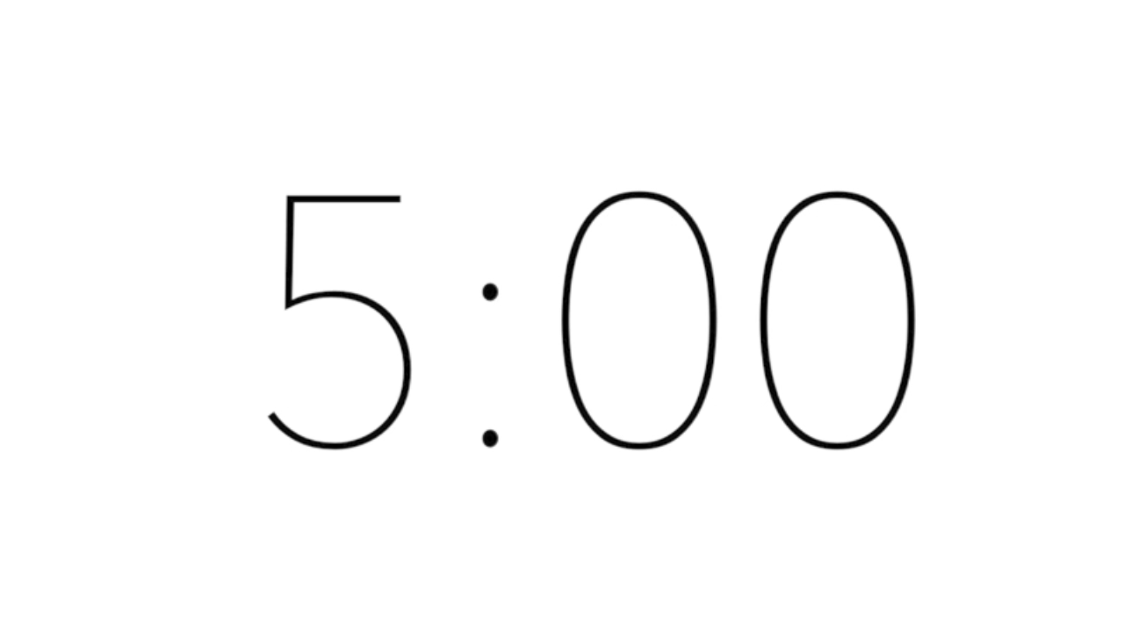
Action
Choose the best idea out of your top 5 and give it a name.

Slide 76
Prototyping

Slide 77
The persona prototype.
Grandpa Joe and Grandma Mary

Slide 78
The Problem
Grandpa Joe and Grandma Mary live in a large town with plenty of friends and a large family. They like their independence but keep forgetting simple things like when to take their medicine, the names of people they know, grandchildren’s ages and birthdays, their shopping lists and a few other things. This is really embarrassing for them sometimes so can you help them?

Slide 79

One Possible Solution
Meet Bobby. Bobby is a virtual ‘Grandson’ created to help Joe and Mary overcome some of the problems they face. With Bobby they can use the camera on their phone to point at a face and it will tell them who they are and will remind them not only to take their pills, but also when they need to go to the doctor to get more. As Joe and Mary have difficulty using the tiny keyboard on their phone Bobby has big colourful icons and can even be voice activated by either Joe or Mary.

Slide 80
The Outcome
With Bobby’s help Joe and Mary are now no longer worried that they may forget the name of people they meet, or forget to take their pills on time, or how old their grandchildren are, or when its their birthday.
In fact they are really happy to have Bobby’s help and feel even more independent.

Slide 81

Action
Create your persona prototype.

Slide 82
Action
Give feedback on other persona prototypes and give ideas on how to make it better.
For example:
“I like that your project does…”
“I wish that it did…”

Slide 83
Action
Use the feedback to make your prototype better.

Slide 84
1.
Find a problem to solve
2.
Understand the problem
3.
Find possible solutions
4.
Select and build your ideas
5.
Check the Microsoft AI Principles and Ethics
6.
Submit your project

Slide 85
Check in
Does your project follow the ethics we talked about earlier?

Slide 86
Siddhartha video
Notes:
Ethics check in, Siddhartha Chatuvedi, Product Marketing Manager, Health, Innovation and AI

Slide 87
The Microsoft ethics principles
Fairness
Treat all people fairly and equally.
Reliability & Safety
Perform reliably and safely.
Privacy & Security
Respect everyone’s privacy.
Inclusiveness
Empower and engage everyone.
Transparency
AI systems should be easy-to-understand.
Accountability
AI systems should be responsible and have algorithmic accountability.

Slide 88
Write Your Ethics Statement

Slide 89
Ethics statement.
Fairness: | We believe our AI concept is fair because…
Inclusiveness: | We believe our AI concept is inclusive because…
Reliability & Safety: | We believe our AI concept is reliable and safe because…
Privacy & Security: | We believe our AI concept respects privacy and is secure because…
Transparency: | We believe our AI concept is understandable because…
Accountability: | We believe our AI concept is accountable because…

Slide 90
Example.
Fairness:
We believe our AI concept is fair because our Robo-Jury does not make any decisions based on appearance. The AI does not see a picture of the person, or even see their name, so that they cannot make decisions for a person based on their cultural background.

Slide 91
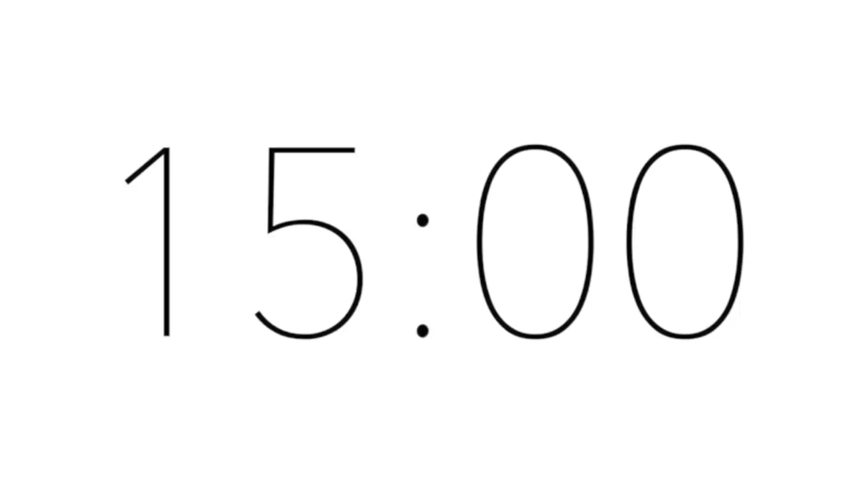
Action
Write the ethics statement
for your AI idea.

Slide 92
Check Your Ethics
Discuss the ethics of your project with other teams to make sure you didn’t miss anything.

Slide 93
Criteria
Judges will assign 1, 2, or 3 points for each criterion:

Slide 94
Criteria, cont’d
Judges will assign 1, 2, or 3 points for each criterion:

Slide 95
Action
Swap projects with another team and determine the ethics score that you would give them.
Help each other find areas for improvement.

Slide 96
1.
Find a problem to solve
2.
Understand the problem
3.
Find possible solutions
4.
Select and build your ideas
5.
Check the Microsoft AI Principles and Ethics
6.
Submit your project

Slide 97
Check in
Feeling good about your idea?
Get ready to submit!

Slide 98
Prepare your presentation
Project Submission
(Microsoft PowerPoint presentation using the Project Submission Template from the Imagine Cup Junior website no longer than ten slides)
Title Page/Title Slide
Table of Contents
Identify which AI for Good Initiative you chose:
AI for Earth
AI for Health
AI for Humanitarian Action
AI for Accessibility
AI for Cultural Heritage
State your problem
Summarize your research and list the resources your team used to help understand the problem.
Generally describe how your Final Project solves a problem. For example it may:
create or improve something that will eventually lead to a solution to the real-world problem
create or improve a service that addresses the real-world problem
communicate a message to an audience responsible for addressing the real-world problem, or its consequences.
Tell how your project idea is ethical.
Consider: Fairness, Reliability and Safety, Privacy, Inclusiveness, Transparency, and Accountability
Creatively show how your Final Project engages the problem and why this solution is needed.
Describe the format of the Final Project and how it uses Artificial Intelligence (be specific, how will it work, what form will it take, and why is it the best solution for engaging the real-world problem)

Slide 99
Action
How can you make your submission be even better?

Slide 100
Criteria
Judges will assign 1, 2, or 3 points for each criterion:

Slide 101
Criteria, cont’d
Judges will assign 1, 2, or 3 points for each criterion:

Slide 102
Submit to your educator!

Slide 103
Want to take your AI learning even further?

Slide 104
Wick Editor video
Notes:
Get hands on with Azure, Shana Matthews, Program Manager, Student Developer Advocacy

Slide 105
Stretch Challenge
To get started with your stretch challenge, educators can download the guide at www.imaginecup.com/junior

Slide 106
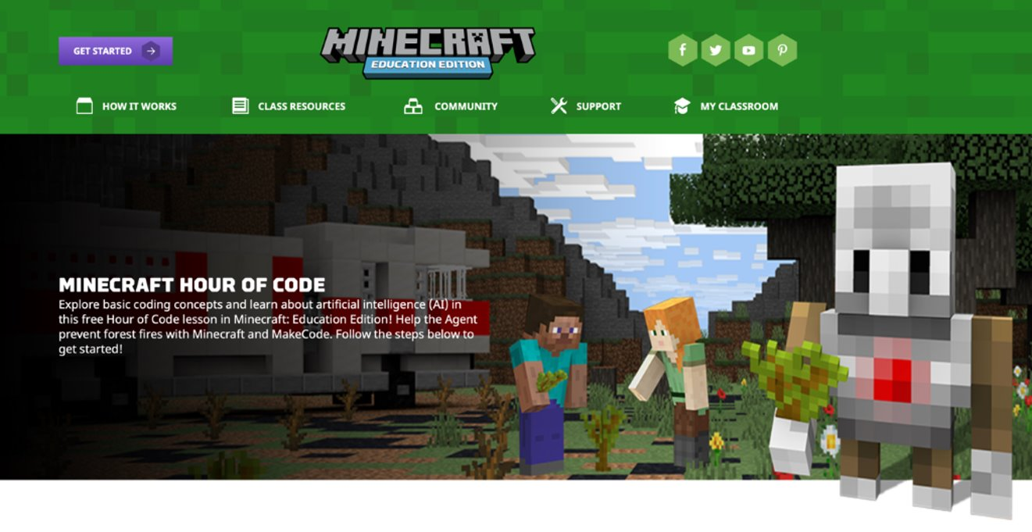
Introduction to Minecraft
Explore basic coding concepts and learn about artificial intelligence (AI) in this free Hour of Code lesson in Minecraft: Education Edition! Help the Agent prevent forest fires with Minecraft and MakeCode. ​
​
The course with full instructions can be found on this link: ​
https://education.minecraft.net/hour-of-code ​
​

Slide 107
Pablo video
Notes:
Imagine Cup Junior next steps, Pablo Veramendi, Global Competition Manager, Imagine Cup

Slide 108
Good luck!

Slide 109
Submission
Educators, to submit projects visit www.imaginecup.com/junior
Submissions open 3 February and close 12 May

Slide 110
Build your project in a day

